Slide 1
Explainable AI
Rick Kuhn, CSD and Raghu Kacker, ACMD

Slide 2
What is the problem?
Artificial intelligence and machine learning (AI/ML) systems have exceeded human performance in nearly every application where they have been tried
AI is starting to be incorporated into consumer products. This trend is accelerating, and AI will be increasingly used in safety-critical systems
AI systems are good, but sometimes make mistakes, and human users will not trust their decisions without explanation
There is a tradeoff between AI accuracy and explainability: the most accurate methods, such as convolutional neural nets (CNNs), provide no explanations; understandable methods, such as rule-based, tend to be less accurate

Slide 3
What is the current state of the art?
Black-box statistical predictions are inadequate
Explanations must be understandable to non-specialist

Slide 4
Tradeoff:
Expert system:
Good for explanations,
not so good for accuracy
- OR -
Neural nets:
Good for accuracy,
not so good for explanations
How do we get the
best of both worlds?

Slide 5
What can NIST do?
The classification problem in machine learning is closely related to the problem of fault location in combinatorial testing for software.
The objective in both cases is to identify a small number of interactions, out of possibly billions or more, that trigger a failure (in combinatorial testing) or produce a conclusion (in machine learning).
We have methods and tools for fault location in combinatorial testing that could be adapted to ML problems, to identify the rare combinations of variable values that produce conclusions in AI systems.
This approach has not been applied to AI/ML before.
NIST has established the leading project in combinatorial software testing

Slide 6
Fault location
Given: a set of tests that the SUT fails, which combinations of variables/values triggered the failure?
variable/value combinations in passing tests
variable/value combinations in failing tests
Combinations in failing but not in passing tests These are the ones we want – how do we find them?

Slide 7
Fault location – what's the problem?
If they're in failing set but not in passing set:
1. which ones triggered the failure?
2. which ones don't matter?
out of v^{t}( ) combinations
n
t
Example:
30 variables, 5 values each, input configuration 5³⁰ ➔ 445,331,250 5-way combinations
142,506 combinations in each test
FInd one or two out of >142,000 that caused failure

Slide 8
Relevance to explainable AI
Non-class feature combinations
aquatic, venomous, 6 legs, ...
Class feature combinations - brown & furry, black & furry, whiskers, claws, ... not aquatic, not venomous, not 6 legs,
Individual feature combinations – brown & furry, whiskers, claws, not aquatic, not venomous, not 6 legs, ...
Animal shares features with cat class
Animal does not share features with non-cat classes

Slide 9
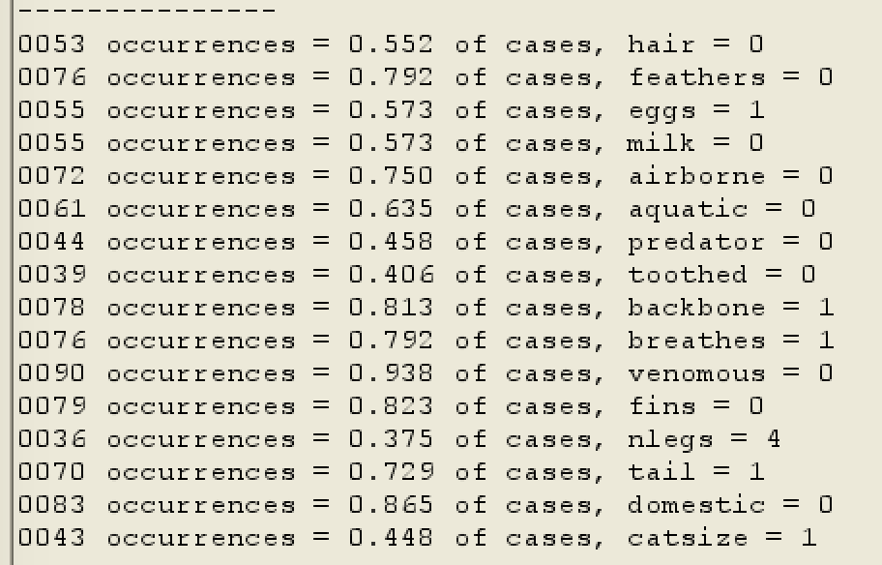
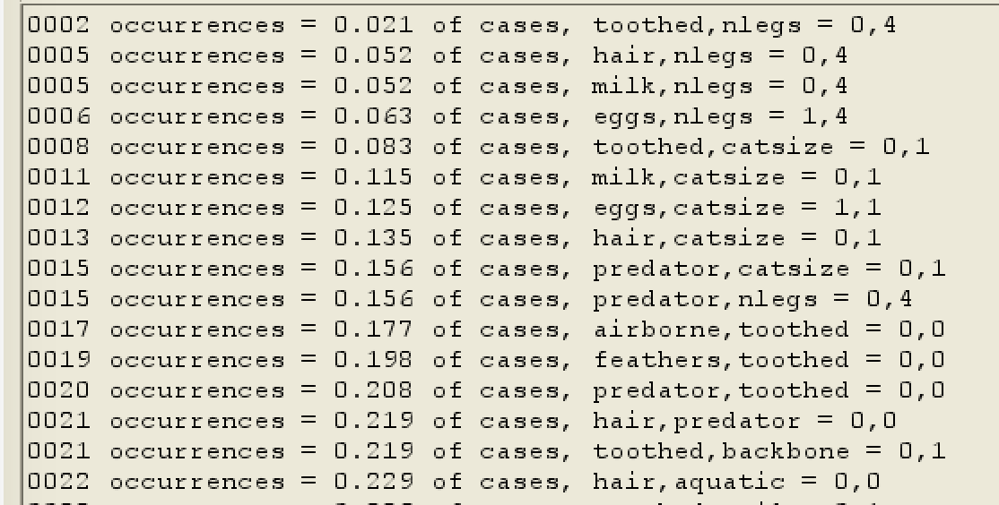
Why is this creature recognized as a reptile?
Input configuration 2¹⁵6¹
No single feature is sufficient explanation – shares features with non-reptiles
No pair of features sufficient – shares 2-way combinations w/ non-reptiles

Slide 10
3-way combinations produce rules to explain recognition of Testudo as a reptile
Only reptiles have these combinations of features:
not aquatic AND not toothed AND four legs
egg-laying AND not aquatic AND four legs
not hairy AND four legs AND cat size
not milk-producing AND not aquatic AND four legs
not milk-producing AND four legs AND cat size
not predator AND not toothed AND four legs
Non-reptiles in the database do not have these 3-way combinations

Slide 11
Sample ML problem
“Titanic survivors” – popular demo problem for ML
Predict which passengers survive, using attributes:
Passenger class: 1st, 2nd, 3rd
Sex
Age: 14 and under, 15 to 20, 21 to 70, over 70
Number of siblings or spouses onboard
Number of parents or children onboard
Embarkation point: Southampton, England; Queenstown, Ireland; Cherbourg, France
Input configuration 2¹3²4¹5²

Slide 12
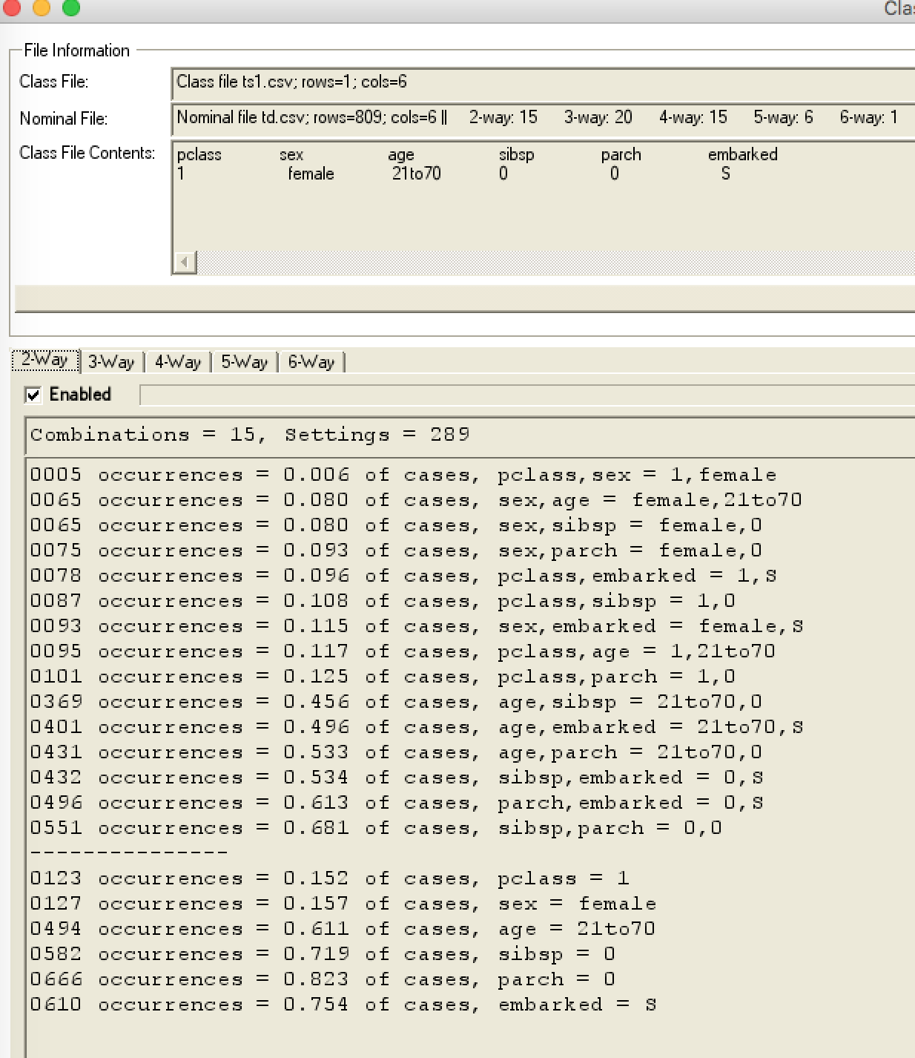
Example using prototype – what factors explain this passenger’s survival?
First class passenger, female aged 21 to 70, no siblings, spouse, parents, or children onboard, from England
What factors differentiate passenger from casualties?
Consider 2-way combinations of factors:
1st class female passengers (like this one) were only 0.6% of casualties
No single factor is adequate explanation: 15% of dead were 1st class; 16% were female; 61% aged 21 to 70
Survival explained by being female passenger traveling first class. Neither of these two factors alone is enough.

Slide 13
Heatmap visualization of factor combinations
Psngr class | Sex | Age | # sibling spouse | #parent child | embarked
1 | f | 21to70 | 0 | 0 | S
Green to red -> more significant to less significant for explanation
Heatmap | female | 21to070 | no sibling/spouse | no parents/children | Southampton
1st class | 0.0062 | 0.1174 | 0.1075 | 0.1248 | 0.0964
female |  | 0.0803 | 0.0803 | 0.0927 | 0.1150
21 to 70 |  |  | 0.4561 | 0.5328 | 0.4957
no sibling/ spouse |  |  |  | 0.6811 | 0.5340
no parents/ children |  |  |  |  | 0.6131

Slide 14
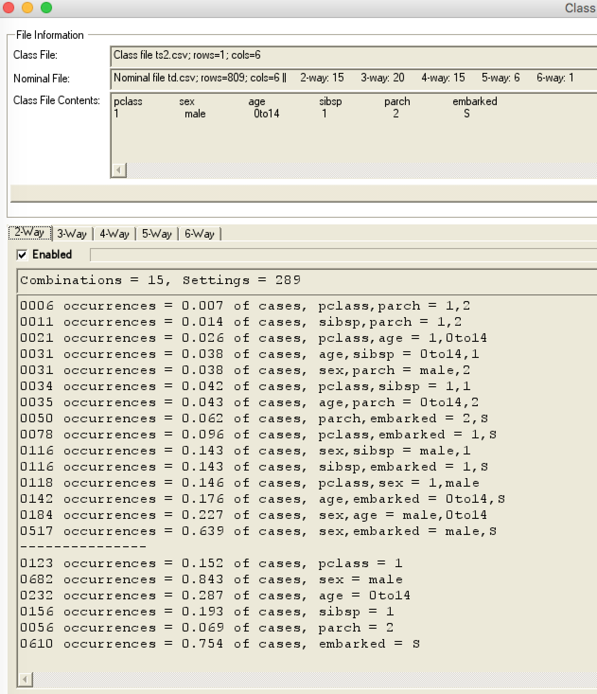
Another example– what factors explain this passenger’s survival?
First class passenger, male child, with one sibling, two parents onboard, from England
What factors differentiate passenger from casualties?
Consider 2-way combinations of factors:
1st class passengers with two parents onboard (like this one) were only 0.7% of casualties
No single factor is adequate explanation: 15% of dead were 1st class; 84% were male; 29% were children 14 and under
Survival explained by being child with parents traveling first class. No single factor alone is enough. Easily seen in 3-way combinations:

Slide 15
Mapping combinations to expressions
Report identifies t-way combinations that distinguish the predicted class from others
Combinations can be mapped to expressions to produce a rule-based type of explanation
if (1st class passenger AND female) OR (female AND age 21to70) OR (female AND no siblings/spouses) then SURVIVE if (1st class passenger AND age 14 or under AND parents onboard) OR (1st class passenger AND age 14 or under AND siblings onboard) then SURVIVE
As noted, none of the single factors above is sufficient for explanation

Slide 16
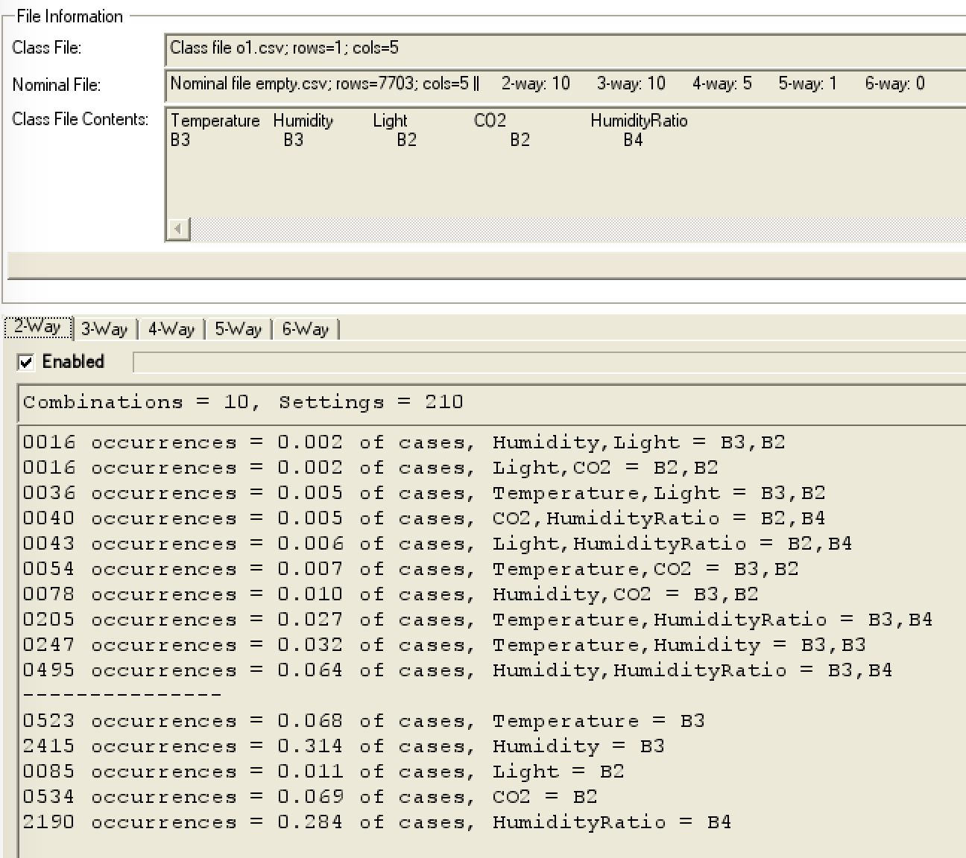
Example: empty vs. occupied rooms, using sensor data
Why do we conclude this room is occupied?
These levels of humidity and lighting are strong indication
Considering levels of lighting, CO2, and humidity ratio provide even stronger evidence:
Empty rooms don’t have these levels

Slide 17
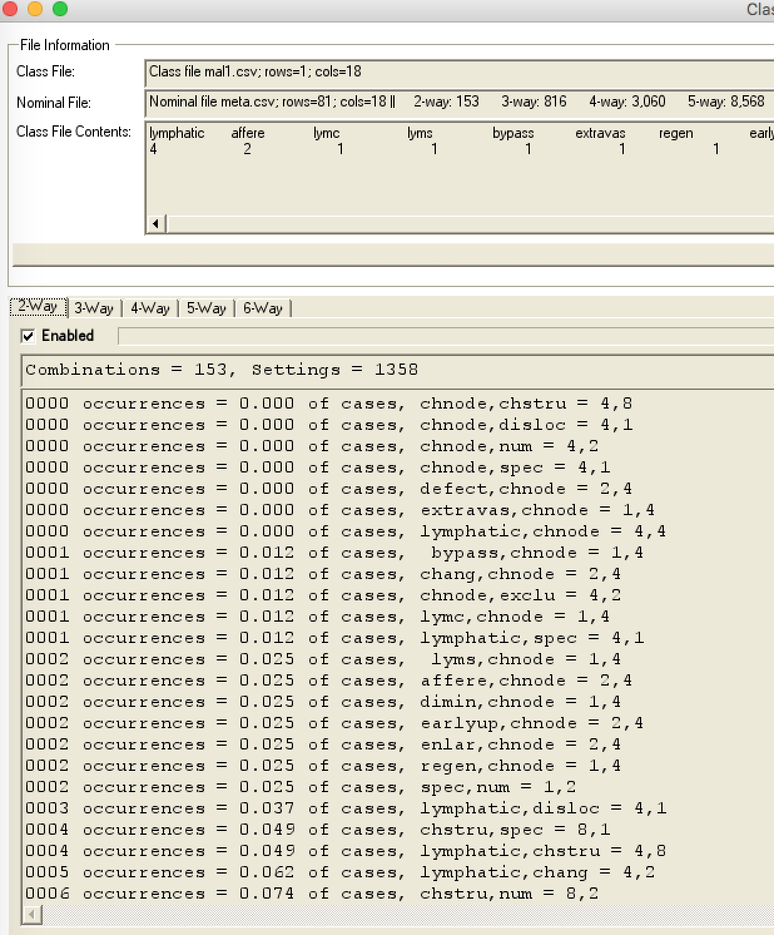
A different example: lymph node pathology – why is this classified as malignant not metastatic?
These combinations are characteristic of lymphoma that arises in lymph node instead of metastatic that spread to node from somewhere else

Slide 18
Summary
Combinatorial methods can provide explainable AI
We have prototype that applies this approach
Determine combinations of variable values that differentiate an example from other possible conclusions
Feature combinations present shared with class
Feature combinations not shared with class not present
Method can be applied to black-box functions such as CNNs
Present explanation in the preferred form of rules, “if A & B, or C with D & E, then conclusion is X”

Slide 19
Summary
Explainability is a critical problem in the acceptance of artificial intelligence/machine learning, especially for critical applications
Human users will not trust AI if conclusions cannot be explained
Methods from combinatorial software testing can be applied to solving the problem of explainable AI
We have prototype that applies this approach
Determine combinations of variable values that differentiate an example from other possible conclusions
Feature combinations present shared with class
Feature combinations not shared with class not present
Present explanation in the preferred form of rules, “if A & B, or C with D & E, then conclusion is X”
Method can be applied to black-box functions such as CNNs

Slide 20
What has been tried?
Interpretable models – e.g. rule-based expert systems: “if patient has symptoms A and B, or has B with C and D, then illness is X”
best for explanations
hard to find rules
less accurate than other approaches
Modify neural nets etc. to add explanations
reduces accuracy, complicates the system
explanations still not very understandable
Model induction - infer explainable model from black-box
flexible for application, good explanations using only input, output
hard to produce the explainable model
Our approach – derive rule predicates from inputs and outputs to CNNs and other black-box functions

