Slide 2
Managing Inheritance
Stephanie Lacy (Senior Solutions Architect)

Slide 3
Objective
Determine how to manage inheritance across the different use-cases that a customer may experience when converting or creating an OSCAL SSP package for delivery.

Slide 4
Three Major Inheritance Models
Control is Exported – this system to become a leveraged authorization
Control is owned exclusively by the system
Control is Inherited – Leveraging a pre-existing authorization

Slide 5
Assumptions
Systems can both Inherit and Export a statement
Systems can inherit a single control from multiple providers
When fully inherited, system are not required to provide a local description (statement from leveraged authorization is used instead)
When implementation statements from Leveraged Authorization not available, a default description will be created to reference the ATO package
Parameters will be set to the statement level. If nested statements, each associated parameter will be included in the applicable statement
Props like “implementation-status” a FedRAMP use case and requires the name space attribute.

Slide 6
User Stories – (USE and Test Cases) for Inheritance
This System
Control is this-system level
Inheritance
Control is Inherited with Leveraged Authorization providing SSP
Control is partially inherited with Leveraged Authorization providing SSP
Control is Inherited without Leveraged Authorization providing SSP
Control is partially inherited without Leveraged Authorization providing SSP
Control is Inherited from multiple leveraged Authorizations without providing SSP
Control is partially inherited from multiple Leveraged Authorizations without providing SSP
Control is inherited from multiple Leveraged Authorizations (both with and without SSP referenced)
Control is partially inherited from multiple Leveraged Authorizations (both with and without SSP referenced)
Export
Control is exported and SSP is provide for inheritance
Hybrid
inheritance use-cases, with the addition of the export feature.

Slide 7
Implementing Use-cases
OSCAL SSP Model

Slide 8
Local Control Implementation (where component is this-system)
By-component UUID referenced from the UUID of this-system
Responsible-role associated to roles and parties identified in metadata
Method 5 is leveraged to prevent collisions, standardizes references and associations, and allows for easier identification of content change.

Slide 9
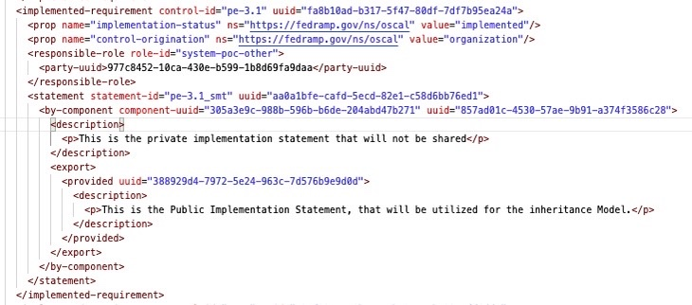
Local Control Implementation with Export (Root Inheritance)
Notes:
Within the same component, identify what information can be shared. This is data is the portion that is “leveraged”

Slide 10
Basic Control Inheritance
UUID of Leveraged Authorization sourced from ”this-system” component of its SSP.
Component is created for “system” to reference for control implementation
Fully Inherited controls leverage the authorization to demonstrate control implementation

Slide 11
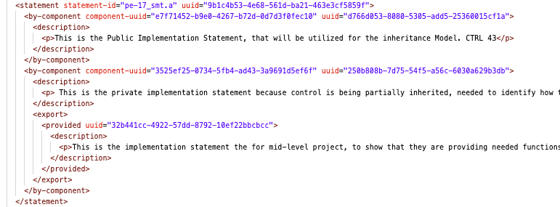
More Complex executions – Same basic principles
Notes:
Inheriting and exporting the same statement. Two different components, one represents the leveraged authorization, and one is ”this-system”.

Slide 12
Handling Inheritance – when Leveraged Authorization SSP’s are missing…
Implementation descriptions from Leveraged authorizations are not always available. This does not restrict the ability to inherit.
Required content available can be identified with “Stock” data, so the Assessors can quickly identify and take appropriate action.

Slide 13
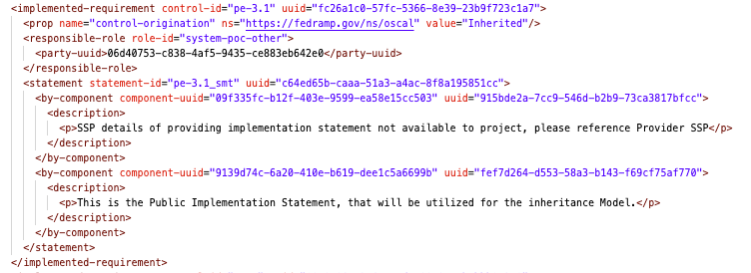
Inheritance – when statement is not available
Notes:
Could be due to access restrictions, reciprocity requirements, availability, and need to know.
If fully inheriting a control, you need to ascertain that the control is being met (IE they are accredited) and trust the accreditation process.
When partially inheriting a control, the shared responsibility model showcased in component definitions can be leveraged to show demarcation of control ownership.

Slide 14
Validation
Validate Schema
Validate Contents
Notes:
Is the SSP in the right format, structure, and contain all required elements?
Xmllint
Oscal-cli
Does the information within the SSP meet the requirements for submission?
UI Validator available on FedRAMPs website
FedRAMP validator cli tool.

Slide 15
Questions?

