Slide 1
Combinatorial Coverage for Assured Autonomy
The 1st IEEE International Workshop on Assured Autonomy, Artificial Intelligence and Machine Learning
Charlotte
October 31, 2022
Rick Kuhn, Raghu Kacker, M S Raunak National Institute of Standards and Technology
Gaithersburg, Maryland 20899

Slide 2
(Slide from Darryl Ahner, US Air Force Institute of Technology)

Slide 3
Software safety assurance is already very expensive
For commercial software:
50% code development, 50% verification
For aviation life-critical: 12% code development, 88% verification (Software is about 30% of cost for new civilian aircraft, higher for military)
Autonomy makes the problem even harder!

Slide 4
Autonomy makes the problem even more expensive!

Slide 5
Why can’t we use the same processes as other safety-critical software ?
Nearly all conventional software testing is based on structural coverage – ensuring that all statements, decisions, paths are tested
Life-critical aviation software requires MCDC (Modified Condition Decision Coverage) testing, a white-box criterion that is not useful for neural nets and other black-box methods

Slide 6
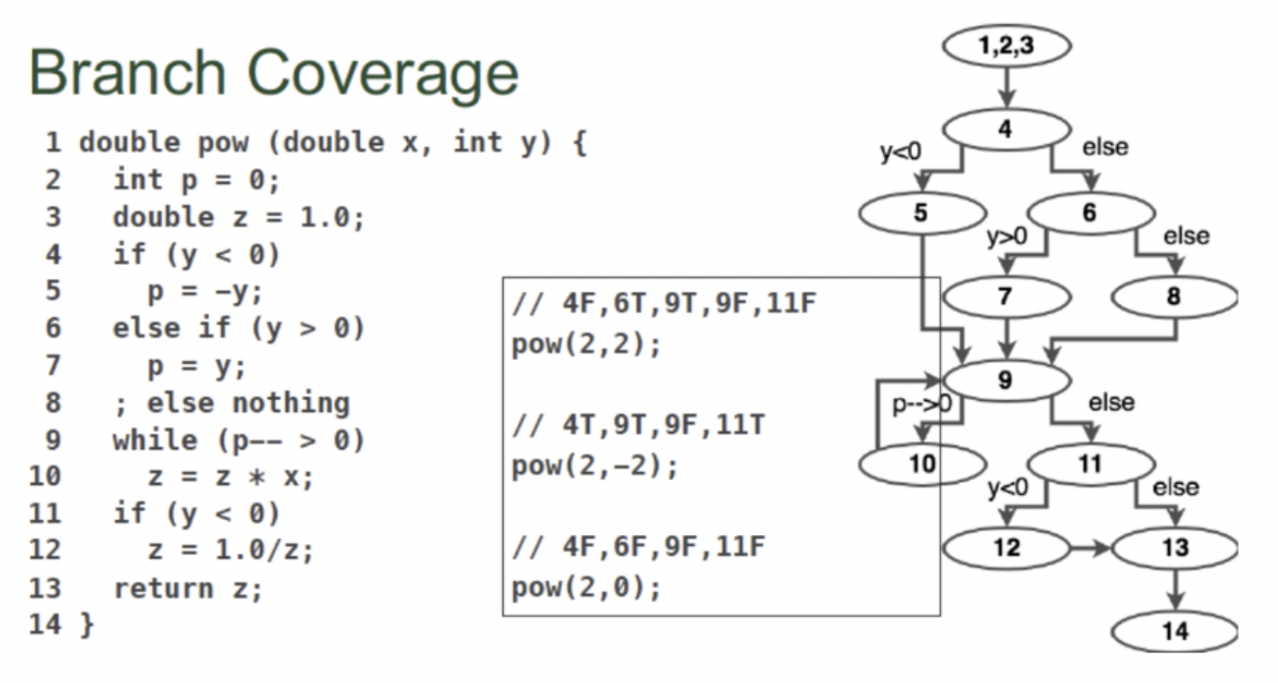
Code coverage works well - for conventional software

Slide 7
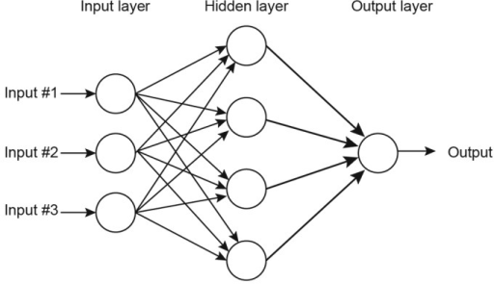
Can we use code coverage for machine learning?
Much of AI/ML depends on various neural nets
Algorithm and code stays the same
Connections and weights adjusted (changed)
Behavior changes depending on inputs used in training

Slide 8
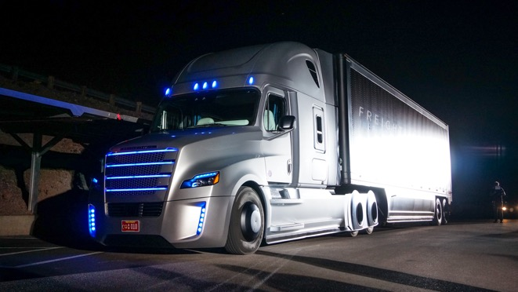
To monitor and guard input space, need to measure
Gold standard of assurance and verification of life-critical software can’t be used for much of new life-critical autonomy software
We can measure “neuron coverage”, an indirect measure and not clear how closely related to accuracy and ability to correctly process all of the input space
Nobody at the wheel …
Measure the input space directly
Then see if the AI system handles all of it correctly

Slide 9
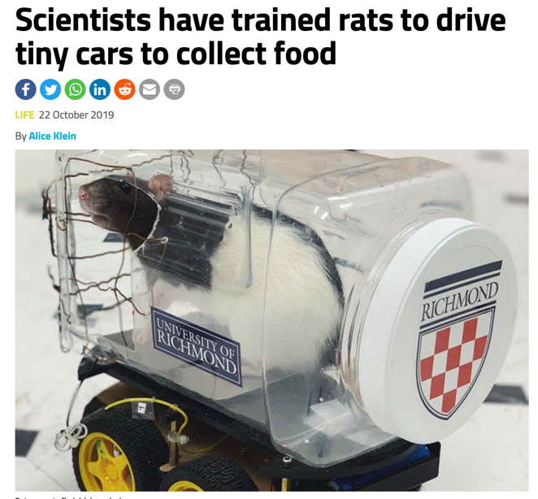
But can they do it under all kinds of conditions ?
It doesn’t take much intelligence to drive a car. Even rats can do it!
The problem is harder outside of a constrained environment

Slide 10
Testing is difficult in complex environment
Multiple conditions involved in accidents
"The camera failed to recognize the white truck against a bright sky”
"The sensors failed to pick up street signs, lane markings, and even pedestrians due to the angle of the car shifting in rain and the direction of the sun”
We need to understand what combinations of conditions are included in testing

Slide 11
Combinatorial input space coverage
a | b | c | d
0 | 0 | 0 | 0
0 | 1 | 1 | 0
1 | 0 | 0 | 1
0 | 1 | 1 | 1
Vars | Combination values | Coverage
a b | 00, 01, 10 | .75
a c | 00, 01, 10 | .75
a d | 00, 01, 11 | .75
b c | 00, 11 | .50
b d | 00, 01, 10, 11 | 1.0
c d | 00, 01, 10, 11 | 1.0
19 combinations included in test set
100% coverage of 33% of combinations
75% coverage of half of combinations
50% coverage of 16% of combinations
Kuhn, D. R., Mendoza, I. D., Kacker, R. N., & Lei, Y. (2013). Combinatorial coverage measurement concepts and applications. 2013 IEEE Sixth Intl Conference on Software Testing, Verification and Validation Workshops

Slide 12
Vars | Combination values | Coverage
a b | 00, 01, 10 | .75
a c | 00, 01, 10 | .75
a d | 00, 01, 11 | .75
b c | 00, 11 | .50
b d | 00, 01, 10, 11 | 1.0
c d | 00, 01, 10, 11 | 1.0
Total possible 2-way combinations = $2^{2}\left(\begin{matrix}4 \\ 2\end{matrix}\right)=24$
S₂ = fraction of 2-way combinations covered = 19/24 = 0.79
Rearranging the table:
1.00 | 00 | 00
.75 | 01 | 01 | 00 | 00 | 00
.50 | 10 | 10 | 01 | 01 | 01 | 00
.25 | 11 | 11 | 10 | 10 | 11 | 11
 | bd | cd | ab | ac | ad | bc

Slide 13
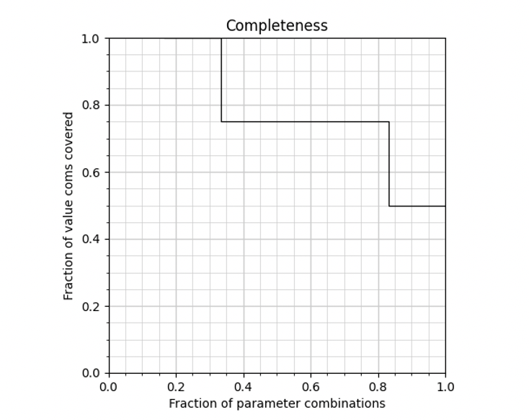
Graphing Coverage Measurement
1.00 | 00 | 00
.75 | 01 | 01 | 00 | 00 | 00
.50 | 10 | 10 | 01 | 01 | 01 | 00
.25 | 11 | 11 | 10 | 10 | 11 | 11
 | bd | cd | ab | ac | ad | bc
S₂ = area under curve = 0.79
M₂
100% coverage of .33 of combinations
75% coverage of .50 of combinations
50% coverage of .16 of combinations
Bottom line:
All combinations covered to at least .50

Slide 14
What else does this chart show?
1 - S_{t} = Untested combinations
(look for problems here)
S_{t} = Tested combinations => code works for these

Slide 15
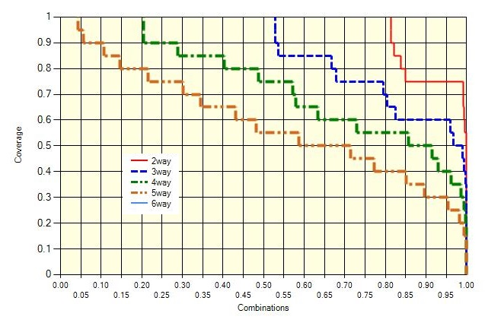
A real-world example: Spacecraft software 82 variables, 7,489 tests, conventional test design (not covering arrays)
Input space not tested: 2-way
Input space not tested: 3-way

Slide 16
What levels of input space coverage are seen in practical ML data sets?
Examples from WEKA data mining demo set
Goal: enumerating all conditions that matter
Opportunity?

Slide 17
Research questions
Practical ML examples don’t seem to have very high input space coverage (previous slide)
Can we improve results with better input space coverage?
Empirical data show that small numbers of factors are involved in system failures (generally 1 to 6).
Is this also true of autonomous systems?
How are input space coverage and classification/prediction accuracy related?
Can we apply some of these methods to temporal aspects? (sequence covering arrays)

Slide 18
Transfer learning – what is the problem?
Differences inevitably exist between training data sets, test data sets, and real-world application data
Further differences exist between data from two or more different environments
How do we predict performance of a model trained on one data set when applied to another?
New environment
Changed environment
Additional possible values
etc.
Lanus, E., Freeman, L. J., Kuhn, D. R., & Kacker, R. N. (2021, April). Combinatorial Testing Metrics for Machine Learning. In 2021 IEEE Intl Conference on Software Testing, Verification and Validation Workshops (ICSTW)

Slide 19
Transfer learning – conventional practice
Randomized selection – but will randomization be sufficient, especially with smaller data sets?
Ensure at least one of each object type – but this may not be representative of object attribute distributions
Interactions are critical to consider in most ML problems, especially for safety, but conventional practice does little to ensure data sets are adequately representative of interactions

Slide 20
Example – image analysis
Planes in satellite imagery – Kaggle ML data set – determine if image contains or does not contain an airplane
Two data sets – Southern California (SoCal, 21,151 images) or Northern California (NorCal, 10,849 images)
12 features, each discretized into 3 equal range bins

Slide 21
Transfer learning problem
Train model on one set, apply to the other set
Problem –
Model trained on larger, SoCal data applied to smaller, NorCal data → performance drop
Model trained on smaller, NorCal data applied to larger, SoCal data → NO performance drop
This seems backwards!
Isn’t it better to have more data?
Can we explain this and predict it next time?

Slide 22
Density of combinations in one but not the other data set, 2-way
Image from Combinatorial Testing Metrics for Machine Learning, Lanus, Freeman, Kuhn, Kacker, IWCT 2021
For C = SoCal, N = NorCal, |C\N| / |C| = 0.02 |N\C| / |N| = 0.12
The NorCal data set has fewer “never seen” combinations, even with half as many observations

Slide 23
Assured autonomy – more questions than answers
Interactions of learning components with programmed components – especially replacing humans
Changes the nature of system failures
More like failures involving human factors issues? ☺ Turing test for bugs! Distinguish between human-triggered and AI-triggered system failures?

Slide 24
Assured autonomy – key points & current state
For capability and cost reasons, autonomous components are becoming routine in software engineering
Many, or most, methods used in high assurance conventional systems do not apply to many autonomous components
Structural coverage – not for neural nets, and others
Formal proofs – for some parts but limited
How to deal with learning, dynamic changes in system, routine non-determinism?
Developing appropriate measures of test adequacy

Slide 25
Please contact us if you’re interested!
Rick Kuhn, Raghu Kacker, M S Raunak
{kuhn, raghu.kacker, raunak}@nist.gov
http://csrc.nist.gov/acts

