Slide 1
Blockmatrix Data Structure and Hyperledger Implementation
Rick Kuhn Josh Roberts
US National Institute of Standards and Technology
Computer Security Division
kuhn@nist.gov joshua.roberts@nist.gov
Notes:
Will broaden topic just a bit from blockchains to distributed ledger systems in general
Introduce a new data structure for distributed ledger systems that has properties that make it useful for supporting privacy requirements that many regard as not supportable on blockchains
And we have open source software that can be obtained online if you’d like to experiment with it

Slide 2
TL;DR Summary of talk
Blockchain has valuable properties, but conflicts with privacy and exception management – can’t delete private data – can’t correct error entry
Data structure called blockmatrix provides integrity protection of blockchain, but allows controlled edits for privacy, corrections
Blockmatrix is a component for distributed database solutions; it is one design option, blockchain is another, choice depends on application needs
Drop-in compatibility with Hyperledger Fabric

Slide 3
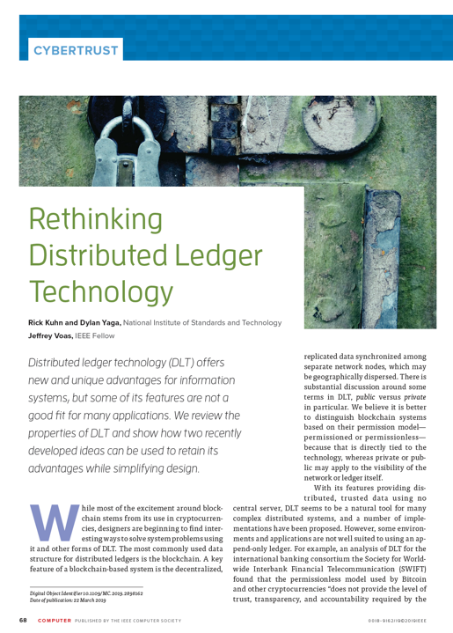
Blockchain/distributed ledger could use a different approach for many applications
Kuhn, R., Yaga, D., & Voas, J. (2019). Rethinking distributed ledger technology. IEEE Computer, 52(2), 68-72.
Kuhn, R. (2018). A Data Structure for Integrity Protection with Erasure Capability. National Institute of Standards and Technology.
Stavrou, A., & Voas, J. (2017). Verified time. IEEE Computer, 50(3), 78-82.

Slide 4
Structure of a Traditional Blockchain
Blockchain has been defined as "an open, distributed ledger that can record transactions between two parties efficiently and in a verifiable and permanent way".
Notes:
So here, finally, we can take a look at what a traditional proof of work blockchain looks like. Each block consists of 2 major parts: the block header and the block data. The block header contains a timestamp (when the block was made), the nonce, a hash of the block data, and finally, a hash of the previous block header. The block data will generally be the transaction list, but might contain other things as well.
The key thing to focus on is that each block contains a hash of the previous blocks header. This is why a blockchain is a CHAIN, and is what makes blockchains so secure: the smallest change in any block makes a chain reaction (excuse the pun) in every single subsequent block. We can trace through this here:
Imagine the data in block 1 changed somehow. Then, the hash of the block data in the block header of block 01 would change. Subsequently, the hash of block 01s header would change since the hash of the block data has changed, and the hash of the block01’s header which block02 contains would be completely different! This would mean the hash of block02’s header, which block03 holds, would also be completely different, and so on and so forth until the end of the chain. As soon as one thing changes after mining, the entire rest of the chain is invalidated!

Slide 5
Why is deletion a problem for blockchains?
Because it is supposed to be – change to one block changes hashes of all; provides integrity protection
Hashes provide assurance that information in every other block is unchanged if one block is modified
If we have to delete a block, hash values for others are no longer valid; requires entire new chain
Don’t want to create a new chain

Slide 6
Why is this a problem for applications?
The permanence/immutability property that makes blockchain technology useful also leads to difficulty in supporting privacy requirements
Privacy rules such as those of European Union General Data Protection Regulation (GDPR) requires that all information related to a particular person can be deleted at that person's request
personal data, defined as "any information concerning an identified or identifiable natural person" - data for which blockchains are designed to be used
"Personal data which have undergone pseudonymisation, which could be attributed to a natural person by the use of additional information should be considered to be information on an identifiable natural person."
Notes:
Many variations of this definition of blockchain, but this is pretty good
Two key words here: verifiable and permanent
New regulations this year that affect just about the whole internet

Slide 7
What is the rationale for blockchain properties?
Blockchain and proof-of-work protocol were designed to solve the problem of double spending in cryptocurrencies.
As with all design choices, blockchain properties have tradeoffs
Proof of work provides an ordering guarantee, => at the expense of enormous processing time and expense
Linked hash records provide trust and integrity guarantee, => at the expense of losing modification or erasure mechanisms required for privacy
Notes:
Many variations of this definition of blockchain, but this is pretty good
Two key words here: verifiable and permanent
New regulations this year that affect just about the whole internet

Slide 8
How well do blockchain properties apply to traditional distributed data management applications?
Cryptocurrency | Finance, supply chain, e-commerce, etc.
1. Partial anonymity | ID required for contracts or government regulation
2. Public access/transparency | Controlled access
3. Small transaction size | Range of message sizes up to large documents, images
4. Immutable records | Changes and deletions, often required by law
5. Proof of work | Flexible consensus models
6. Block ordering guarantees | Timestamps often required
7. Decentralization | Same in many applications
8. Replication | Same in many applications
9. Data integrity guarantees | Same in many applications

Slide 9
Key points – blockchain properties
Blockchain was designed to solve the problem of double-spending in digital currency
Blockchain’s desirable properties have made it attractive for distributed system applications other than cryptocurrency
But many of its features make it very unattractive for distributed applications
Consequently much current research in blockchain is devoted to getting around its built-in properties
We can provide integrity guarantees and sequencing like blockchain but with low resource consumption and allow revising blocks

Slide 10
Can we try something else?
Datablock matrix – uses two hash values per block instead of a linked chain
Java or Go components available as open source
Incorporated into Next Gen Access Control – practical demo
Hyperledger component implementation nearing completion
Verified time – high resolution time stamp instead of ordering guarantee

Slide 11
Changing data in blockchain vs. datablock matrix
Blockchain
Initial data entry -> transaction in a block
Modification -> new transaction keyed to previous
Use key to new value, not allow use of previous, obsolete, value
Dependent on proof of work to ensure sequence
Datablock matrix
Initial data entry -> transaction in a block
Modification -> delete/replace transaction by owner
Use previous key, new value found in block
Sequence not needed since only one value exists

Slide 12
What are attempts at solving this problem?
Don’t put personal data on blockchain
Pseudo-anonymized data are still considered personal
Even if not directly tied to a person – dynamic IP address can be considered personal if it can be indirectly tied
Financial transactions are obviously personal data
Encrypt data and destroy key to delete
Data must be secure for decades
Advancements in cryptography usually compromise old crypto – e.g., quantum computing puts current public key systems at risk
Notes:
Variety of approaches to solving the privacy requirement problem have been proposed
Definition of personal data is very broad, not practical to keep all of it off
Encryption that is safe for decades is hard to provide

Slide 13
What are blockmatrix constraints and assumptions?
Hash integrity protection must not be disrupted for blocks not deleted
Must ensure auditability and accountability
Designed for permissioned/private distributed ledger systems – such as supply chain, medical records management, electronic funds transfer
Provide distributed consensus and guaranteed shared view
Notes:
We want a solution that is generally compatible with current distributed ledger systems

Slide 14
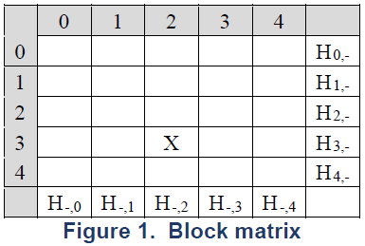
New data structure solution: a datablock matrix
A data structure that provides integrity assurance using hash-linked records while also allowing the deletion of records
Stores hashes of each row and column
=> each block within the matrix is protected by two hashes
Suggested use for private/permissioned distributed ledger systems
Notes:
Block Matrices at their core are a newly designed data structure that are designed to be secure despite allowing deletion or modification of existing items in them.
The structure can be seen in the top right: Essentially, it is a matrix which stores the hash of the each of its rows and columns. The way it could be actually implemented in code
could vary, but for the sake of this image and conceptually, you can imagine that each row and column is terminated with a hash of that row and column. More specifically, it
Would be the hash of the combined contents of each block in that row and each block in that column.
The size can vary, but in this case it is a 4x4 block matrix. This data structure comes from a NIST CyberSecurity White Paper I have included as a reference at the end of this presentation.

Slide 15
How does this work?
Suppose we want to delete block 12
 | 0 | 1 | 2 | 3 | 4
0 | • | 1 | 3 | 7 | 13 | H_{0,-}
1 | 2 | • | 5 | 9 | 15 | H_{1,-}
2 | 4 | 6 | • | 11 | 17 | H_{2,-}
3 | 8 | 10 | 12 | • | 19 | H_{3,-}
4 | 14 | 16 | 18 | 20 | • | H_{4,-}
 | H_{-,0} | H_{-,1} | H_{-,2} | H_{-,3} | H_{-,4} | etc.
disrupts the hash values of H_{3,-} for row 3 and H_{-,2} and column 2
blocks of row 3 are included in the hashes for columns 0, 1, 3, and 4
blocks of column 2 are included in the hashes for rows 0, 1, 2, and 4
Notes:
Block Matrices at they’re core are a newly designed data structure that are designed to be secure despite allowing deletion or modification of existing items in them.
The structure can be seen in the top right: Essentially, it is a matrix which stores the hash of the each of its rows and columns. The way it could be actually implemented in code
could vary, but for the sake of this image and conceptually, you can imagine that each row and column is terminated with a hash of that row and column. More specifically, it
Would be the hash of the combined contents of each block in that row and each block in that column.
The size can vary, but in this case it is a 4x4 block matrix. This data structure comes from a NIST CyberSecurity White Paper I have included as a reference at the end of this presentation.

Slide 16
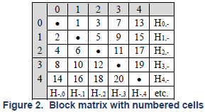
Datablock Matrix Population Algorithm
Algorithm
Basic algorithm is simple, many variations possible
Implemented as Java code
Github project
Block ordering provides desirable properties
Notes:
Beyond this, block matrices can be improved further by populating them in a specific way using the above algorithm. Essentially, what this does is populate the block matrix in the manner you can see in the top block matrix. The numbers represent which block is added where, in order. This creates a few desirable properties that can be useful in some situations. Even though they don’t necessarily make block matrices more useful to the blockchain use case, the block matrix is a general data structure that can be used for different applications and these properties may be useful in other situations.
For one, the block matrix is balanced when it gets filled, in that the half above the diagonal has at most 1 additional cell more than the half below the diagonal. For example, if, say, 9 items have been inserted, we can see that 5 of these would be above the diagonal, and 4 would be below.
Another useful property that this special ordering creates is that it is even possible to delete two consecutive blocks at a time, without recalculating hashes between each deletion, and still maintain integrity. This is due to the empty diagonal, which prevents 2 consecutive blocks from ever being diagonal to each other. We can see the difference between a block matrix with and without the empty diagonal here. Without the diagonal, if you, for example, deleted blocks 7 and 8 without recalculating hashes in between each deletion, we would no longer have integrity for blocks 4 and 9 as both their column and row hashes would be modified, meaning we could no longer be assured they were not modified just from checking their row and column hashes. However, with the empty diagonal, if you delete 1 and 2, or 5 and 6, or any other 2 blocks that are consecutive but also directly diagonal to each other, the empty diagonal prevents any other blocks from losing integrity protection.

Slide 17
Data Structure Properties
Balance: upper half (above diagonal) contains at most one additional cell more than the lower half.
Hash sequence length: number of blocks in a row or column hash proportional to $\sqrt{N}$ for a matrix with N blocks, by the balance property.
Number of blocks: The total number of data blocks in the matrix is $k^{2}−k$ for k rows/columns since the diagonal is null.
Block dispersal: No consecutive blocks in same row or column, in sector 0 (below diagonal) or sector 1(above) for b mod 2 for block b
Notes:
Beyond this, block matrices can be improved further by populating them in a specific way using the above algorithm. Essentially, what this does is populate the block matrix in the manner you can see in the top block matrix. The numbers represent which block is added where, in order. This creates a few desirable properties that can be useful in some situations. Even though they don’t necessarily make block matrices more useful to the blockchain use case, the block matrix is a general data structure that can be used for different applications and these properties may be useful in other situations.
For one, the block matrix is balanced when it gets filled, in that the half above the diagonal has at most 1 additional cell more than the half below the diagonal. For example, if, say, 9 items have been inserted, we can see that 5 of these would be above the diagonal, and 4 would be below.
Another useful property that this special ordering creates is that it is even possible to delete two consecutive blocks at a time, without recalculating hashes between each deletion, and still maintain integrity. This is due to the empty diagonal, which prevents 2 consecutive blocks from ever being diagonal to each other. We can see the difference between a block matrix with and without the empty diagonal here. Without the diagonal, if you, for example, deleted blocks 7 and 8 without recalculating hashes in between each deletion, we would no longer have integrity for blocks 4 and 9 as both their column and row hashes would be modified, meaning we could no longer be assured they were not modified just from checking their row and column hashes. However, with the empty diagonal, if you delete 1 and 2, or 5 and 6, or any other 2 blocks that are consecutive but also directly diagonal to each other, the empty diagonal prevents any other blocks from losing integrity protection.

Slide 18
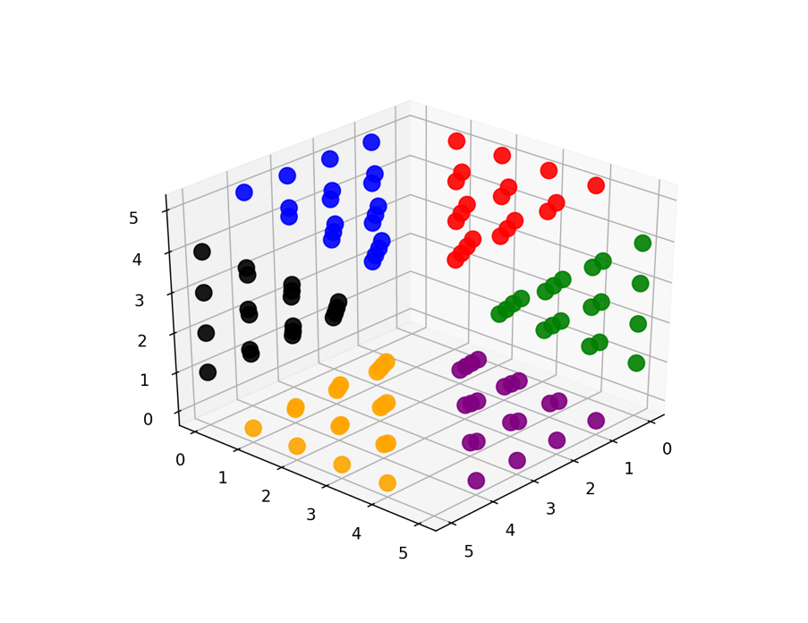
Structure can be extended to multiple dimensions
Block dispersal for 3 dimensions
Location in sectors 0..5 according to b mod 6 for block b

Slide 19
Comparison Summary
Blockchain
Integrity protection
Transparency – global
Permanence, proof of work
New approach
Integrity protection
Transparency – global
Editable, timestamps

Slide 20
So what? Why use this data structure?
Enlarge the market for blockchain
Solve the conflict between blockchain and privacy regulations
Allow for exception management
Replace network communication with local data
You can obviously do this with conventional database functions
New data structure adds integrity checks as in blockchain
Our goal is to make this a basic easy-to-use component for distributed database design.

Slide 21
Distributed ledgers provide a historically consistent data store. If you don’t need that, you don’t need a distributed ledger
CONSIDER: Email / Spreadsheets
NIST blockchain decision flowchart
Do you need a shared, consistent data store?
NO
YES
Does more than one entity need to contribute data?
NO
Your data comes from a single entity. Distributed ledgers are typically used when data comes from multiple entities.
CONSIDER: Database CAVEAT: Auditing Use Cases
Uses handled by blockmatrix that cannot be done in blockchain
YES
AUDITING
Data records, once written, are never updated or deleted?
NO
YES
Sensitive identifiers WILL NOT be written to the data store?
NO
You should not write sensitive information to a blockchain that requires medium to long term confidentiality, such as PII, even if it is encrypted
CONSIDER: Encrypted Database OR blockmatrix
YES
Are the entities with write access having a hard time deciding who should be in control of the data store?
NO
If there are no trust or control issues over who runs the data store, traditional database solutions should suffice
CONSIDER: Managed Database
NO
Are the entities with write access having a hard time deciding who should be in control of the data store?
YES
YES
If you don’t need to audit what happened and when it happened, you don’t need a distributed ledger
CONSIDER: Database
NO
Do you want a tamperproof log of all writes to the data store?
Do you want a tamperproof log of all writes to the data store?
NO
YES
YES
You may have a useful blockchain
use case
You may have a useful data block matrix use case

Slide 22
What about tech transfer?
Received NIST Technology Maturation Acceleration Program funding – for technology transfer and commercialization
Integrating with Next Generation Database Access Control
Patent approved – assures availability of technology
Hyperledger component nearing completion
Notes:
We want a solution that is generally compatible with current distributed ledger systems

Slide 23
Hyperledger blockmatrix implementation
Hyperledger is widely-used open source project started by IBM, Intel, and SAP
Hyperledger Fabric - intended for large distributed systems
Blockmatrix to be dynamic, increasing capacity as more blocks are added
Designed to use existing API as closely as possible – add blocks in same manner as adding to blockchain
Additional API functions to delete/edit, manage access control

Slide 24
Block Structure for Hyperledger
Blocks store key value pairs instead of transactions
The key is stored in the block header along with the block number
The value is stored in the block’s data field
No need to store the hash of the previous block

Slide 25
BlockchainInfo vs BlockMatrixInfo
message BlockchainInfo { uint64 height = 1; bytes currentBlockHash = 2; bytes previousBlockHash = 3;
}
message BlockMatrixInfo { uint64 size = 1; uint64 blockCount = 2; repeated bytes rowHashes = 3; repeated bytes columnHashes = 4;
}
Notes:
The left is what is defined in Hyperledger Fabric 2.3 the right is the block matrix integration.
- BlockchainInfo stores the height of the blockchain, the current block hash and the previous block hash.
- BlockMatrixInfo stores the size of the matrix, the number of blocks, and the row and column hashes

Slide 26
Hyperledger Example

Slide 27
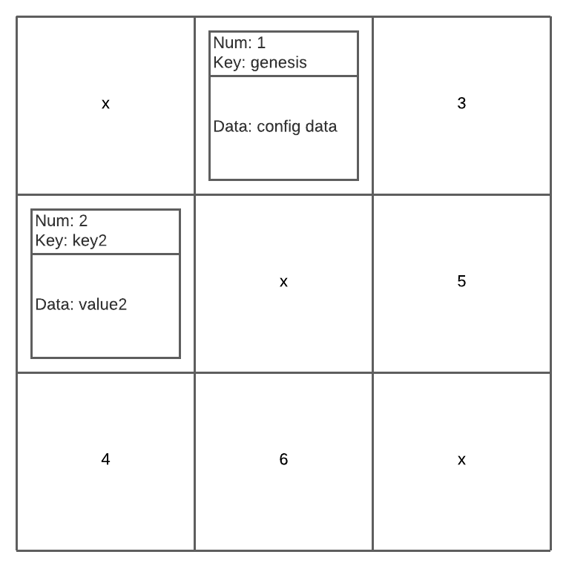
Hyperledger Example
AddBlock(2, “key2”, “value2”)

Slide 28
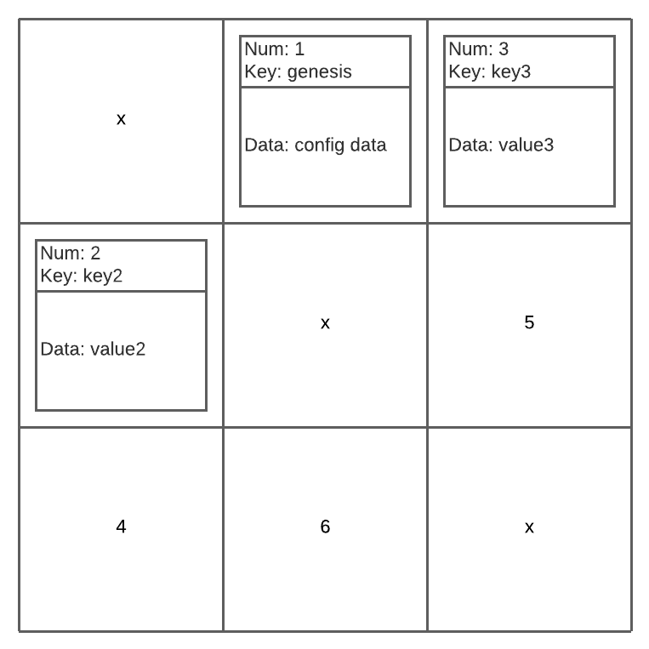
Hyperledger Example
AddBlock(3, “key3”, “value3”)

Slide 29
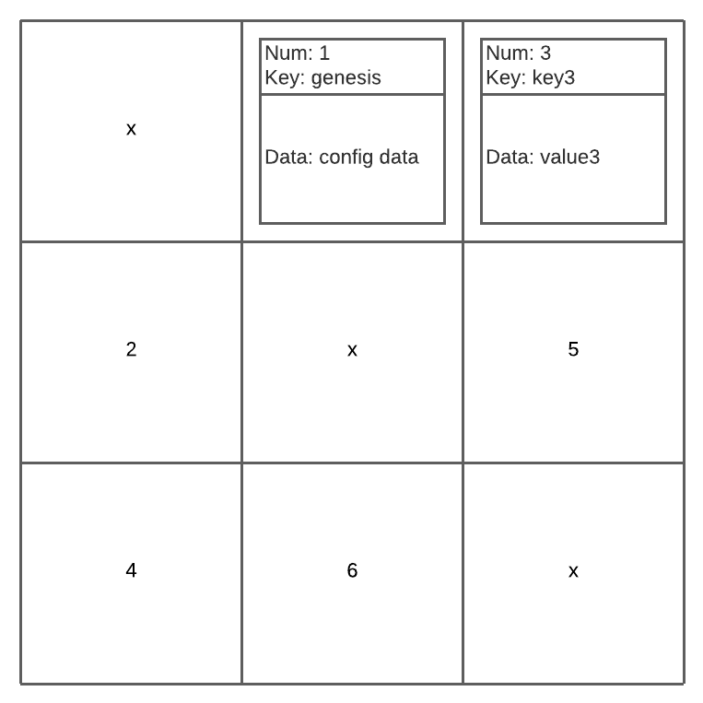
Hyperledger Example
DeleteBlock(2)
Notes:
I’m not sure if this is enough information for it’s own slide so maybe just mention it at this stage of the example.
Different way of handling DeleteBlock. We can:
Not reuse blocks (block numbers will increase but size of database won’t since deleted block numbers will be forgotten about)
Reuse blocks. We can reuse a block number right after it’s been deleted or after a set amount of time.

Slide 30
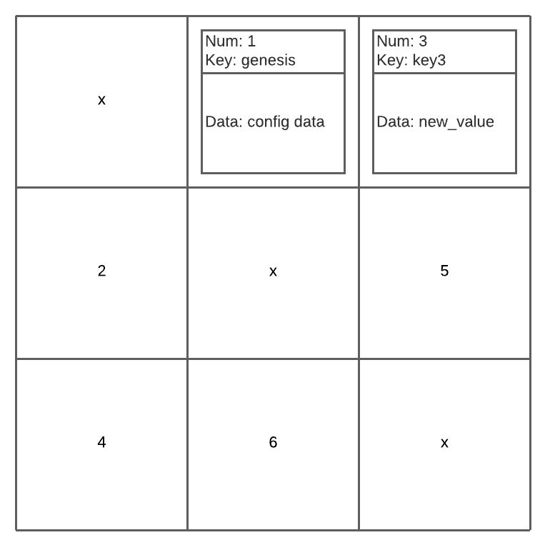
Hyperledger Example
UpdateBlock(“key3”, “new_value”)

Slide 31
Hyperledger Integration Summary
Blocks store key, value pairs
No need to store hashes
Instead of transactions, values are stored
Keys are stored in header
Each block still has a number

Slide 32
Where are we now?
Integrate with Next Gen Database Access Control - completed
Implement blockmatrix as plug-and-play component in Hyperledger Fabric – nearly completed
Demonstrate – logistics/supply chain, clinical trials, electronic funds transfer - also new European Central Bank report says Hyperledger Fabric fits needs of ‘digital euro’ – can blockmatrix help ?
Notes:
We want a solution that is generally compatible with current distributed ledger systems

Slide 33
More information:
Kuhn, R., Yaga, D. and Voas, J., 2019. Rethinking Distributed Ledger Technology. Computer, 52(2), pp.68-72.
Stavrou, A. and Voas, J., 2017. Verified time. Computer, 50(3), pp.78-82.
Kuhn, D. R. (2018). A Data Structure for Integrity Protection with Erasure Capability. https://csrc.nist.gov/publications/detail/white-paper/2018/05/31/data-structure-for-integrity-protection-with-erasure-capability/draft
Project site with links to source code and publications
https://csrc.nist.gov/Projects/enhanced-distributed-ledger-technology
Acknowledgements
Jeff Voas, Dylan Yaga, David Ferraiolo, NIST
Joanna DeFranco, Penn State University
Temur Saidkhodjaev, University of Maryland College Park
Arsen Klyuev, Johns Hopkins University
Gokhan Kocak, Asena, Inc.

